Slide 1


211ECE1400-IOT(Sensors And Devices)
SMART IRRIGATION SYSTEM
Faculty :
Dr.V.Muneeshwaran

Slide 2






TEAM(08) MEMBERS:
K.Karteya Reddy
P.Dinesh Karthik
C.Varun Kumar
C.Nikhil Kumar

Slide 3
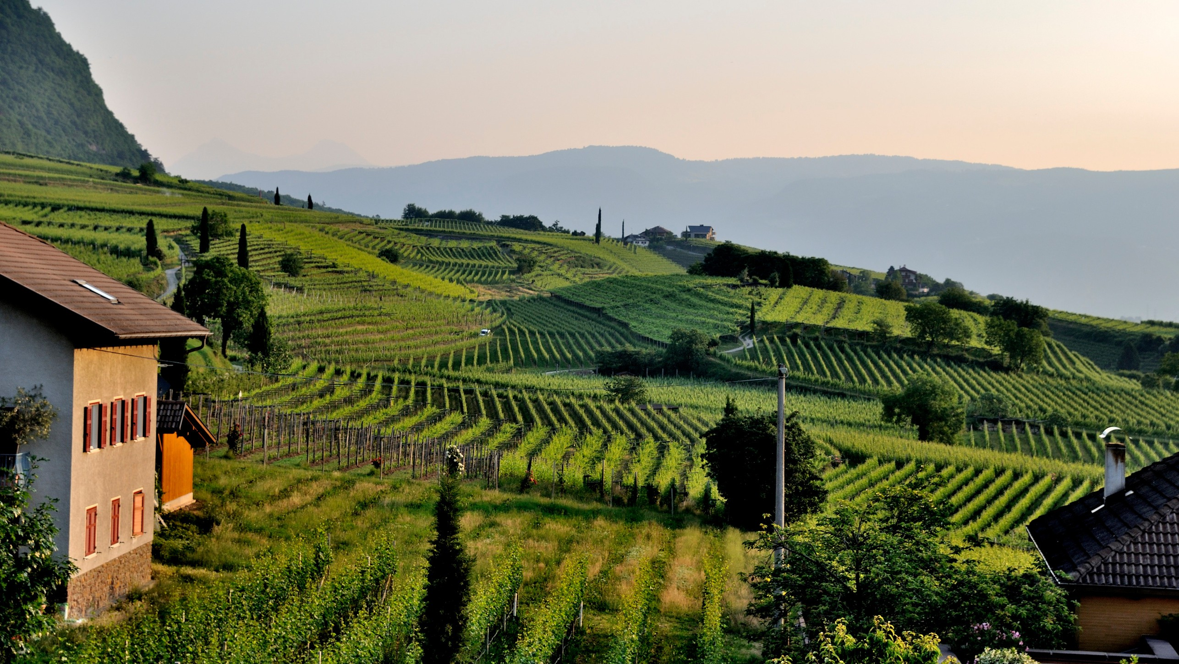

HOOK FOR THE PROBLEM STATEMENT
Nikhil ,a small-scale farmer in a drought-prone village, wakes up every morning at 5 AM to manually water his crops. With no access to modern irrigation systems, he guesses how much water his soil needs based on how dry it "feels" to the touch.
Meanwhile, his neighbor Karteya often over-irrigates her land, thinking more water means healthier crops—only to find wilted plants and a rising electricity bill.
Varun , a government agriculture officer, tries to educate farmers like Nikhil and Karteya about efficient irrigation, but without real-time data, her advice often misses the mark.
Dinesh , a college student from the same village studying IoT, notices how these age-old practices are leading to wasted water, poor yields, and financial stress for the community .
This situation is not unique to one village—millions of farmers across the world still depend on outdated irrigation techniques. With increasing water scarcity and unpredictable weather patterns, there is a clear need for a smart, affordable, and automated solution that ensures crops get just the right amount of water at the right time.

Slide 4
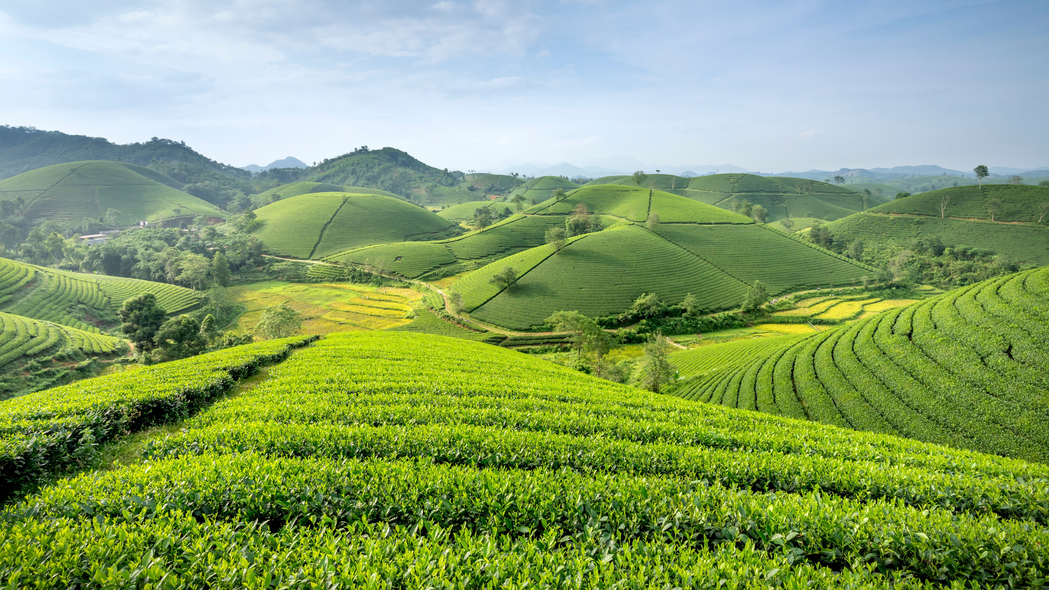
INTRODUCTION
Smart irrigation is an automated watering technique that uses real-time data from IoT sensors (like soil moisture sensors), cloud platforms, and automation systems to supply the right amount of water at the right time—based on crop needs, soil type, and weather.
Goal of the Project
To build a low-cost, smart irrigation system that helps farmers: Reduce water waste
Increase agricultural productivity
Make farming more sustainable and data-driven

Slide 5
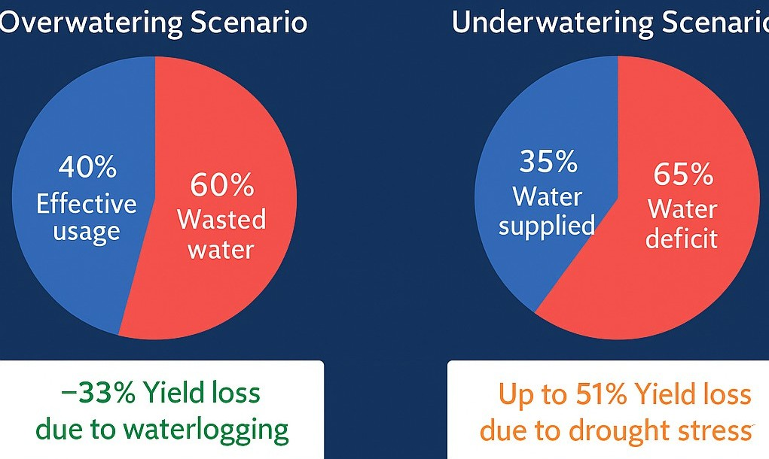
EFFECTS OF IMPROPER IRRIGATION
OVERWATERING SCNARIO
UNDERWATERING SCENARIO

Slide 6

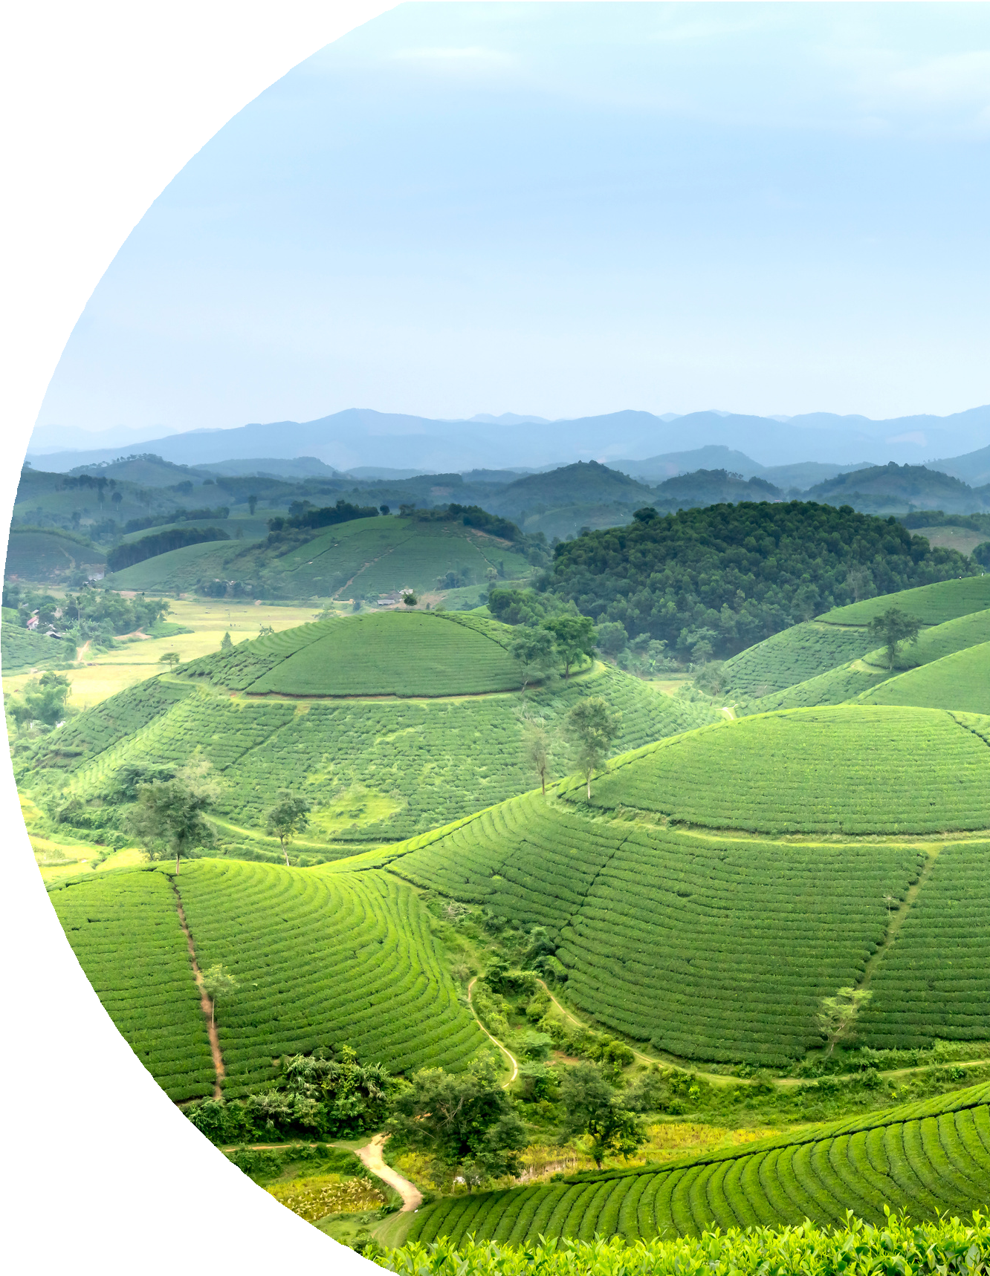
INTENDED SOLUTION
To address inefficient water use and manual irrigation challenges, we propose a Smart Irrigation System that:
Uses a soil moisture sensor to continuously monitor
the water level in the soil.
Sends sensor data to a cloud platform (e.g., Firebase) where it is analyzed in real-time.
Based on:
Crop type
Planting date (to estimate plant age)
Weather and climate data
Moisture thresholds based on crop requirements
the system decides whether irrigation is required.
If the moisture level drops below the required threshold: An LED turns ON (to simulate a water pump in the prototype).
A notification is sent to the farmer via app or SMS. Once the desired level is reached, the LED turns OFF automatically.

Slide 7
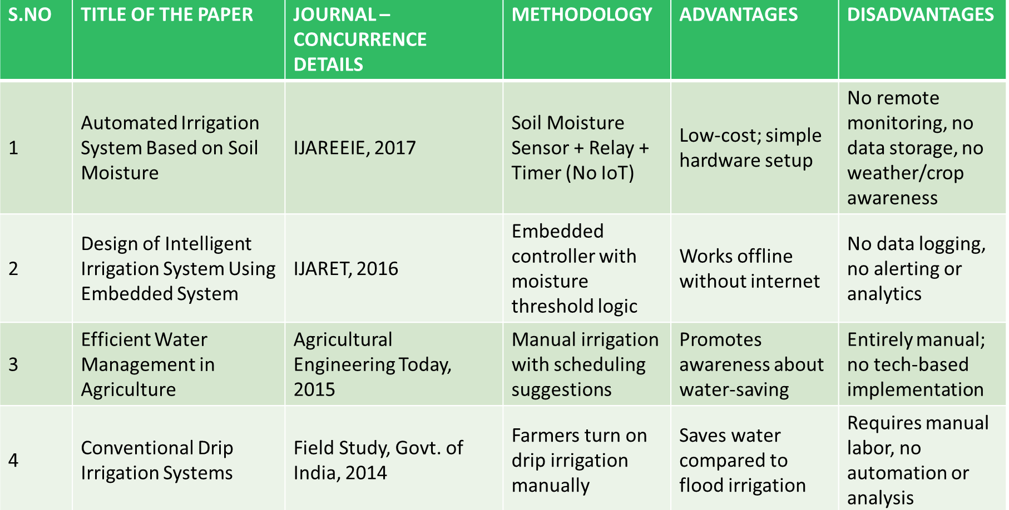
LITERATURE SURVEY

Slide 8
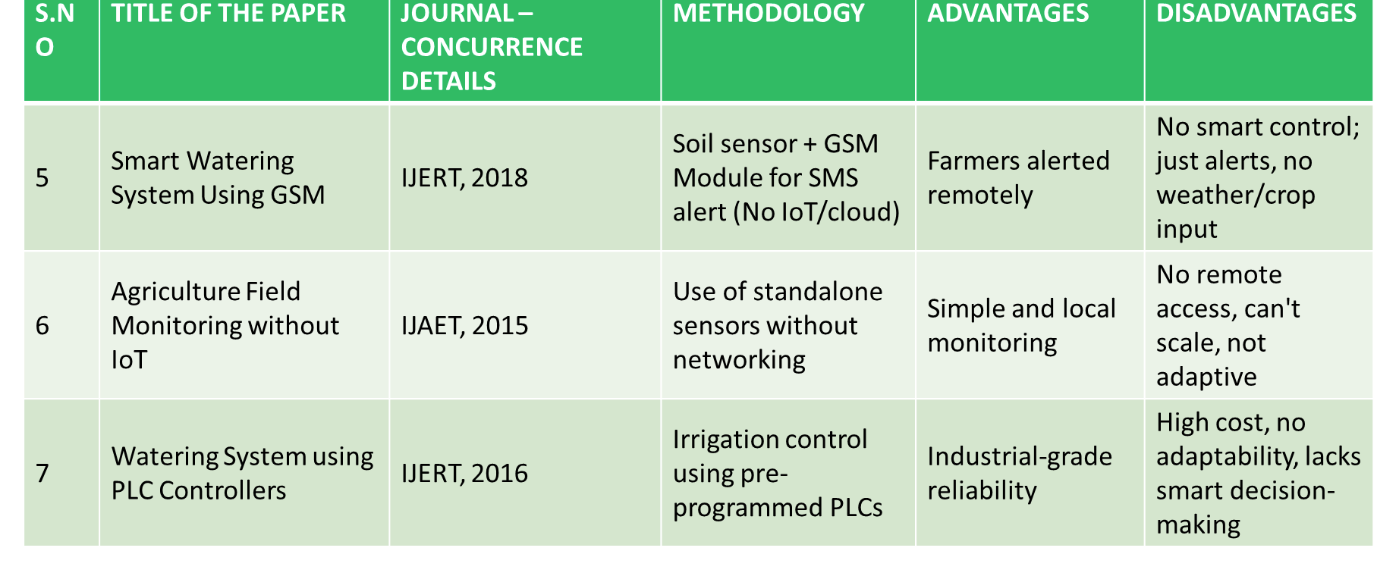

Slide 9
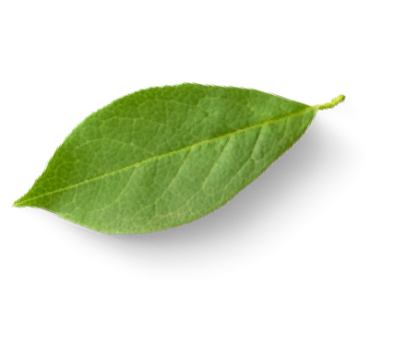

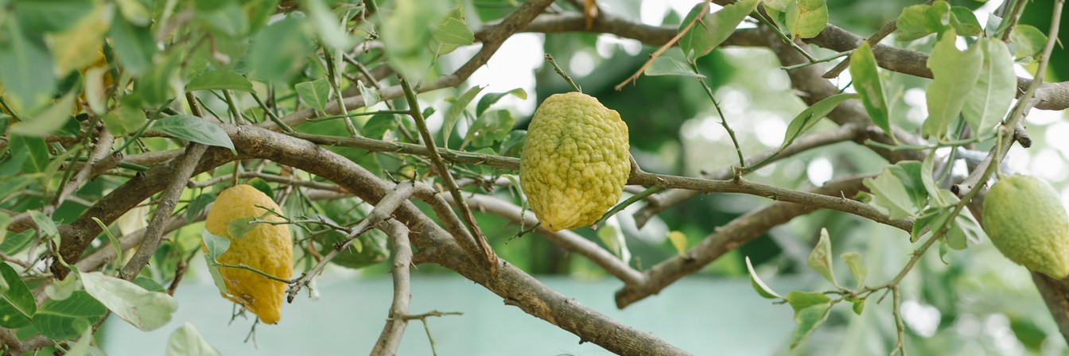
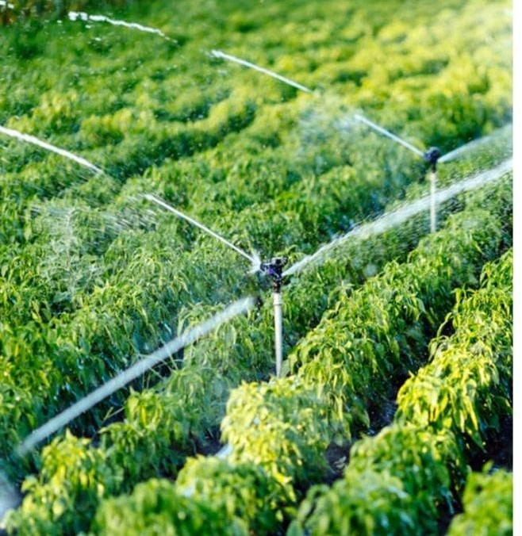
OBJECTIVES
01
Monitor Soil Conditions in Real-Time
Utilize IoT-based soil moisture sensors to track field conditions continuously and accurately.
02
Enable Automated Irrigation Control
Automate irrigation (simulated with LED in prototype) based on real-time sensor data and crop needs.
03
Integrate Weather Forecast and Crop Growth Data
Use cloud-based analytics to combine weather reports, crop type, and planting date for bette⁰r³ water scheduling.
04
Provide Timely Alerts and Recommendations
Notify farmers via cloud platform when irrigation occurs or if attention is needed, offering decision support.
05
Prevent Yield Loss from Over/Under-Irrigation Reduce crop stress and yield
losses—often 20–40%—caused by excess or insufficient watering.
06
Promote Sustainable Water Use
Conserve water by irrigating only when necessary, supporting efficient farming and SDG Goal 2: Zero Hunger.

Slide 10
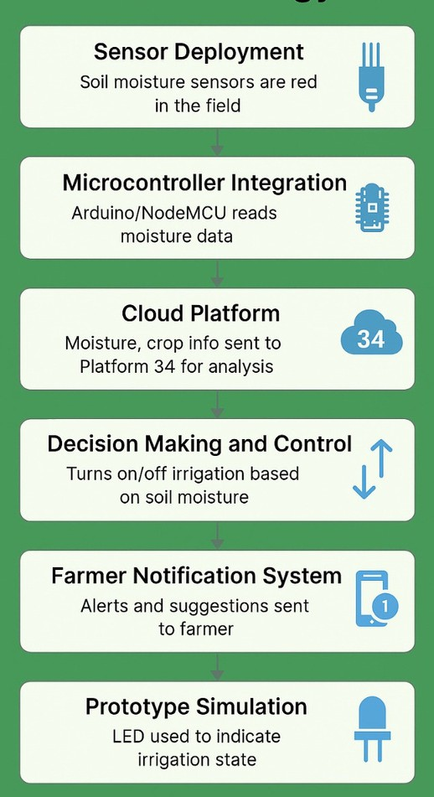
METHODOLOGY
sensor → microcontroller → cloud → decision → notification
→ LED/prototype
Sensor Deployment:
Soil moisture sensors are placed in the field (or pot in prototype) to measure
moisture levels continuously.
Data collected includes real-time soil condition and crop type (manually entered).
Microcontroller Integration:
An Arduino/NodeMCU board reads moisture sensor data.
Based on preset thresholds (based on crop type and age), it makes local decisions
Cloud Platform: Platform 34 (Simulation)
The system sends collected data (moisture, crop info, planting date) to a
cloud service for analysis.

Slide 11
Weather and climate conditions are fetched from online APIs (simulated). Platform 34 calculates plant age and estimates moisture requirement.
Decision Making and Control:
If soil moisture is below required levels, the cloud triggers a command to the controller to turn on
irrigation (simulated using LED).
Once ideal moisture is achieved, it turns off the LED and notifies the user.
Farmer Notification System:
Alerts and suggestions are sent to the farmer via mobile app/SMS/email (can be simulated with print
messages or app mockup).
It may include tips based on crop type, weather alerts, or unusual conditions.
Prototype Simulation: In lab demonstration:
1.
2.
3.
Soil moisture is simulated (e.g., dry/wet sponge). LEDs indicate pump ON/OFF state.
Crop data entered through buttons, app interface, or serial monitor

Slide 12
Final Solution:
We propose an IoT-enabled Smart Irrigation System that automates and optimizes the watering process based on real-time soil moisture data, weather forecasts, and crop information.
Sensors placed in the field constantly monitor soil moisture levels.
A microcontroller (like NodeMCU or Arduino) collects sensor data and sends it to a cloud platform (Platform 34).
The cloud platform analyzes:
Moisture data
Crop type
Planting date (to estimate age) Weather and climate conditions Based on this analysis, the system:
Automatically turns ON/OFF irrigation (simulated using LEDs in prototype)
Sends notifications and suggestions to the farmer for efficient water usage
This solution ensures:
Water is used only when necessary, avoiding over/under-irrigation.
Farmers receive timely alerts and data-driven recommendations.
Overall, it supports sustainable farming practices, helping achieve SDG Goal 2: Zero Hunger.

Slide 13
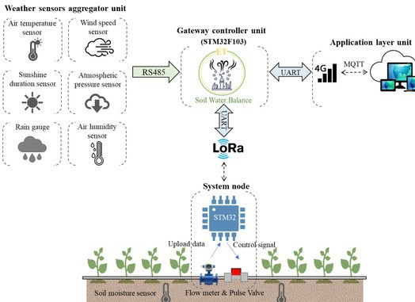
Hardware Components Used:
Software used:
Soil Moisture Sensor
Measures the real-time moisture level in the soil. NodeMCU (ESP8266) / Arduino UNO
Acts as the microcontroller that collects sensor data
and sends it to the cloud. LEDs (for simulation)
Represent the ON/OFF status of the water pump
during demonstration. Breadboard and Jumper Wires
For easy circuit assembly and testing.
Power Supply (Battery/USB Cable) Powers the microcontroller and sensors. Wi-Fi Module (Built-in for NodeMCU)
Sends sensor data to the cloud
platform (Platform 34).
Android Studio
Fire Base
Arduino IDE

Slide 14
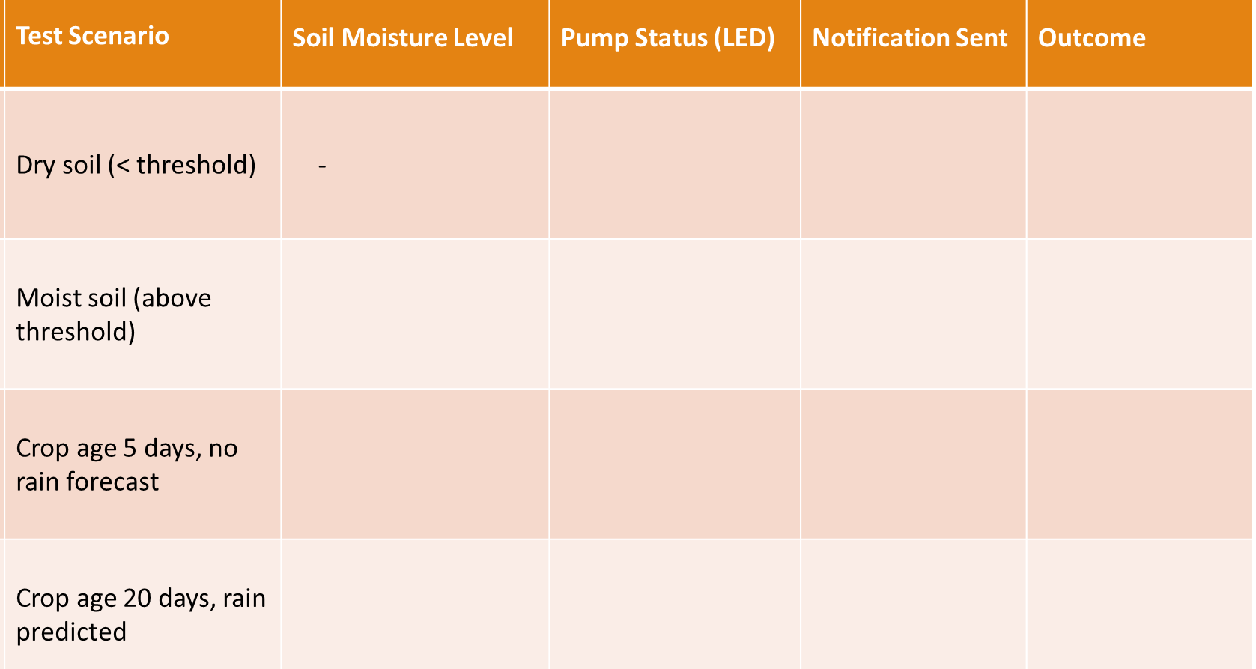
RESULT:

Slide 15
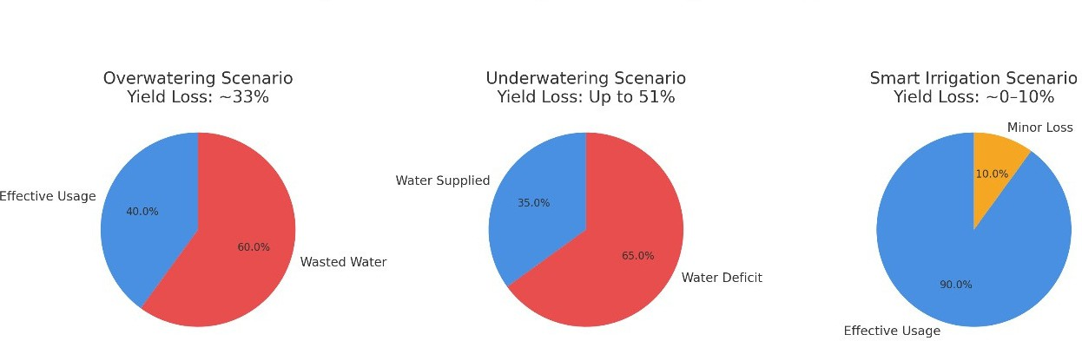
WATER USAGE EFFICIENCT : OVER WATERING vs UNDER WATERING vs SMART IRRIGATIOIN

Slide 16
LINKS:
Water Use Efficiency in Irrigation Systems
Source: Wikipedia – Irrigation Efficiency
Link: https://en.wikipedia.org/wiki/Irrigation#Efficiency
Impact of Overwatering on Yield:
Source: University of Nebraska–Lincoln Extension
Link: https://extensionpubs.unl.edu/publication/2106/html/view
Impact of Underwatering Data Sources:
Yield Response to Deficit Irrigation
Source: Journal of Experimental Botany – Oxford Academic
Link: https://academic.oup.com/jxb/article/58/2/147/534071
eficit Irrigation and Crop Performance:
Source: Air, Soil and Water Research (SAGE Journals / BioOne)
Link: https://bioone.org/doi/full/10.1177/11786221241274019

Slide 17
CONCLUSION:
The IoT-Based Smart Irrigation System effectively demonstrates how modern technologies can address age-old agricultural challenges. By leveraging real-time soil moisture sensors, cloud-based analytics, and automated control mechanisms, the system ensures optimal water usage, improves crop productivity, and supports sustainable farming practices.
This solution not only reduces the risks of over- or under-irrigation but also empowers farmers with timely information and recommendations, thereby contributing to SDG Goal 2 – Zero Hunger. The implementation of this prototype—simulated using LEDs—proves the system's accuracy, responsiveness, and scalability for real- world application.

Slide 18
REFERENCES:
Gnanavel, S., Sreekrishna, M., DuraiMurugan, N., Jaeyalakshmi, M., & Loksharan, S. (2022, January). The smart iot based automated irrigation system using arduino uno and soil moisture sensor. In 2022 4th International Conference on Smart Systems and Inventive Technology (ICSSIT) (pp. 188-191). IEEE.
Morchid, A., Jebabra, R., Alami, R. E., Charqi, M., & Boukili, B. (2024, May). Smart agriculture for sustainability: the implementation of smart irrigation using real-time embedded system technology. In 2024 4th International conference on innovative research in applied science, engineering and technology (IRASET) (pp. 1-6). IEEE.
https://www.researchgate.net/profile/Sitabhra- Majumder/publication/381867727_Water_Management_in_Agriculture_Innovations_for_Efficient_Irrigation
/links/6682e3530a25e27fbc1a4edc/Water-Management-in-Agriculture-Innovations-for-Efficient- Irrigation.pdf
Djalilov, A. U., Gayipov, I. K., Kenesbaev, R. K., Abdunabiyev, Z., Saidov, A., & Axmedov, M. (2022). Development of Automated Intelligent Drip Irrigation System. Galaxy International Interdisciplinary Research Journal, 10(5), 828-841.

Slide 19
Deeksha, R., Choudhary, P., Yalagi, V. S., Basavesha, D., & Yashwanth, S. B. (2021, June). Automatic Irrigation System Using GSM Module. In 2021 International Conference on Design Innovations for 3Cs Compute Communicate Control (ICDI3C) (pp. 93-97). IEEE.
Imam, M. A., & Francis, M. S. (2021). PLC based automated irrigation system. Int. J. Res. Appl. Sci. Eng. Technol, 9, 1519-1525.
Yang, J., Sharma, A., & Kumar, R. (2021). IoT-based framework for smart agriculture. International Journal of Agricultural and Environmental Information Systems (IJAEIS), 12(2), 1-14.

Slide 20
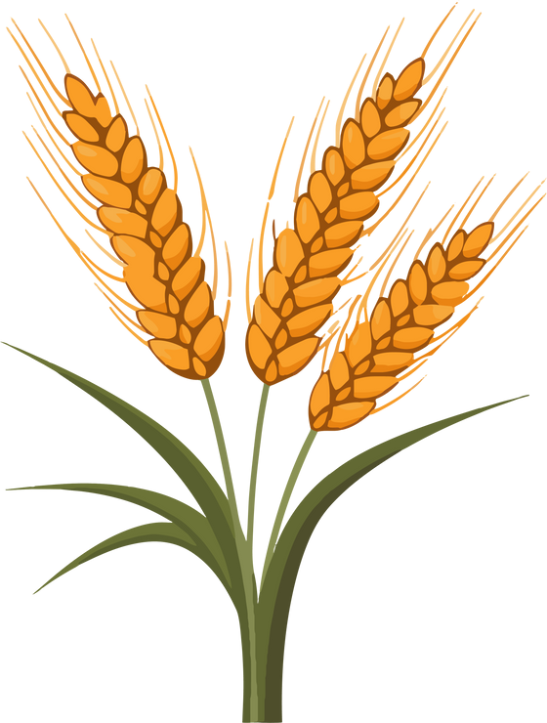
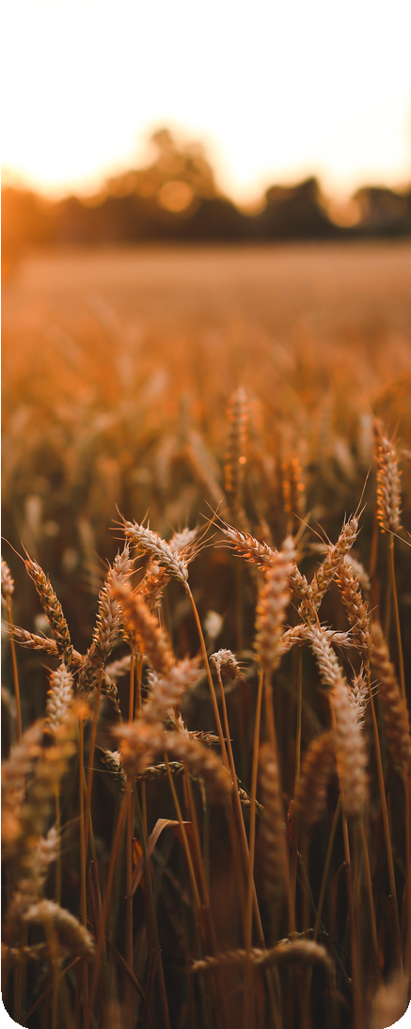
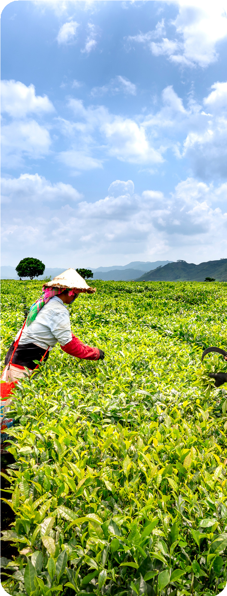
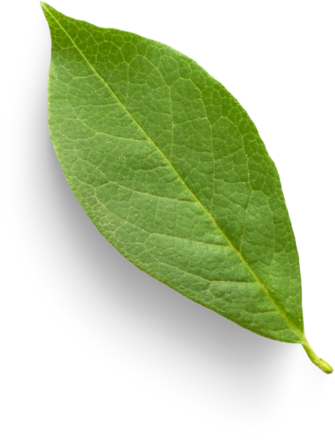
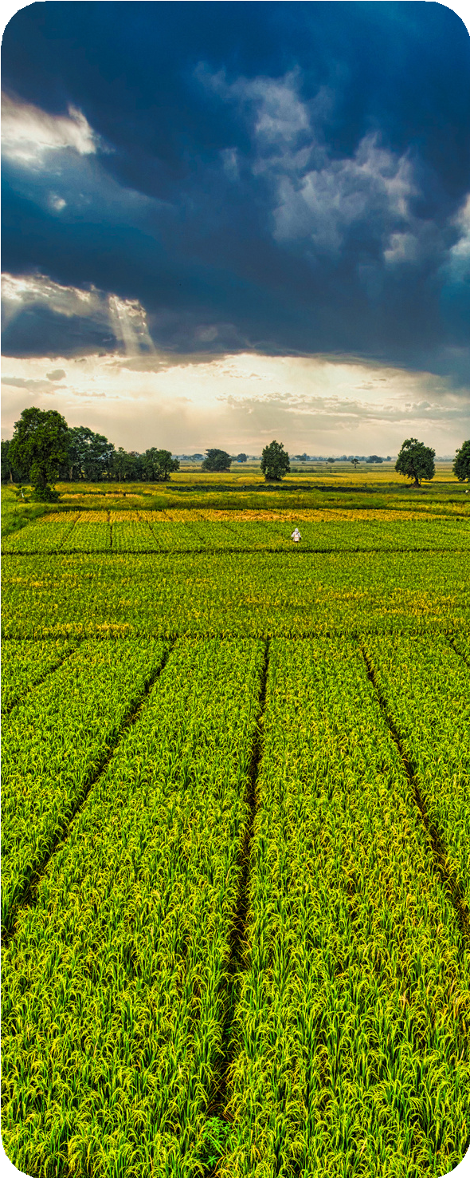
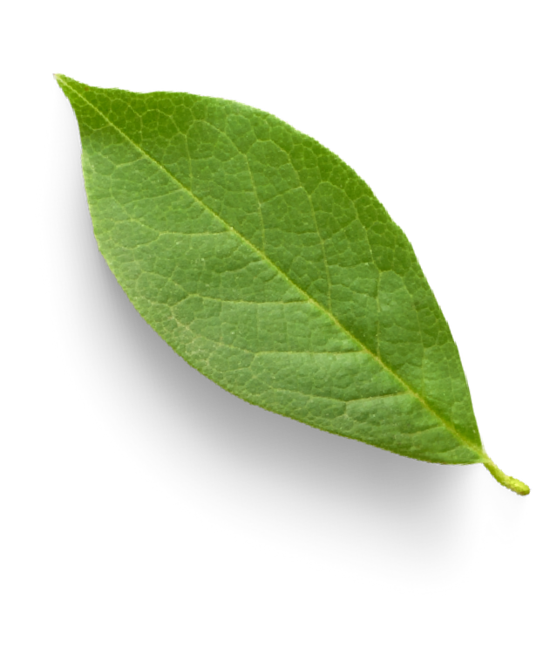
TEAM - 08
Thank
You!

